Slide 1

Notes:
Cover. StoryBrand SB7 opens with the customer as hero: every slide in this deck speaks to the venue operator as 'you'. Clubins enters only as the guide.

Slide 2
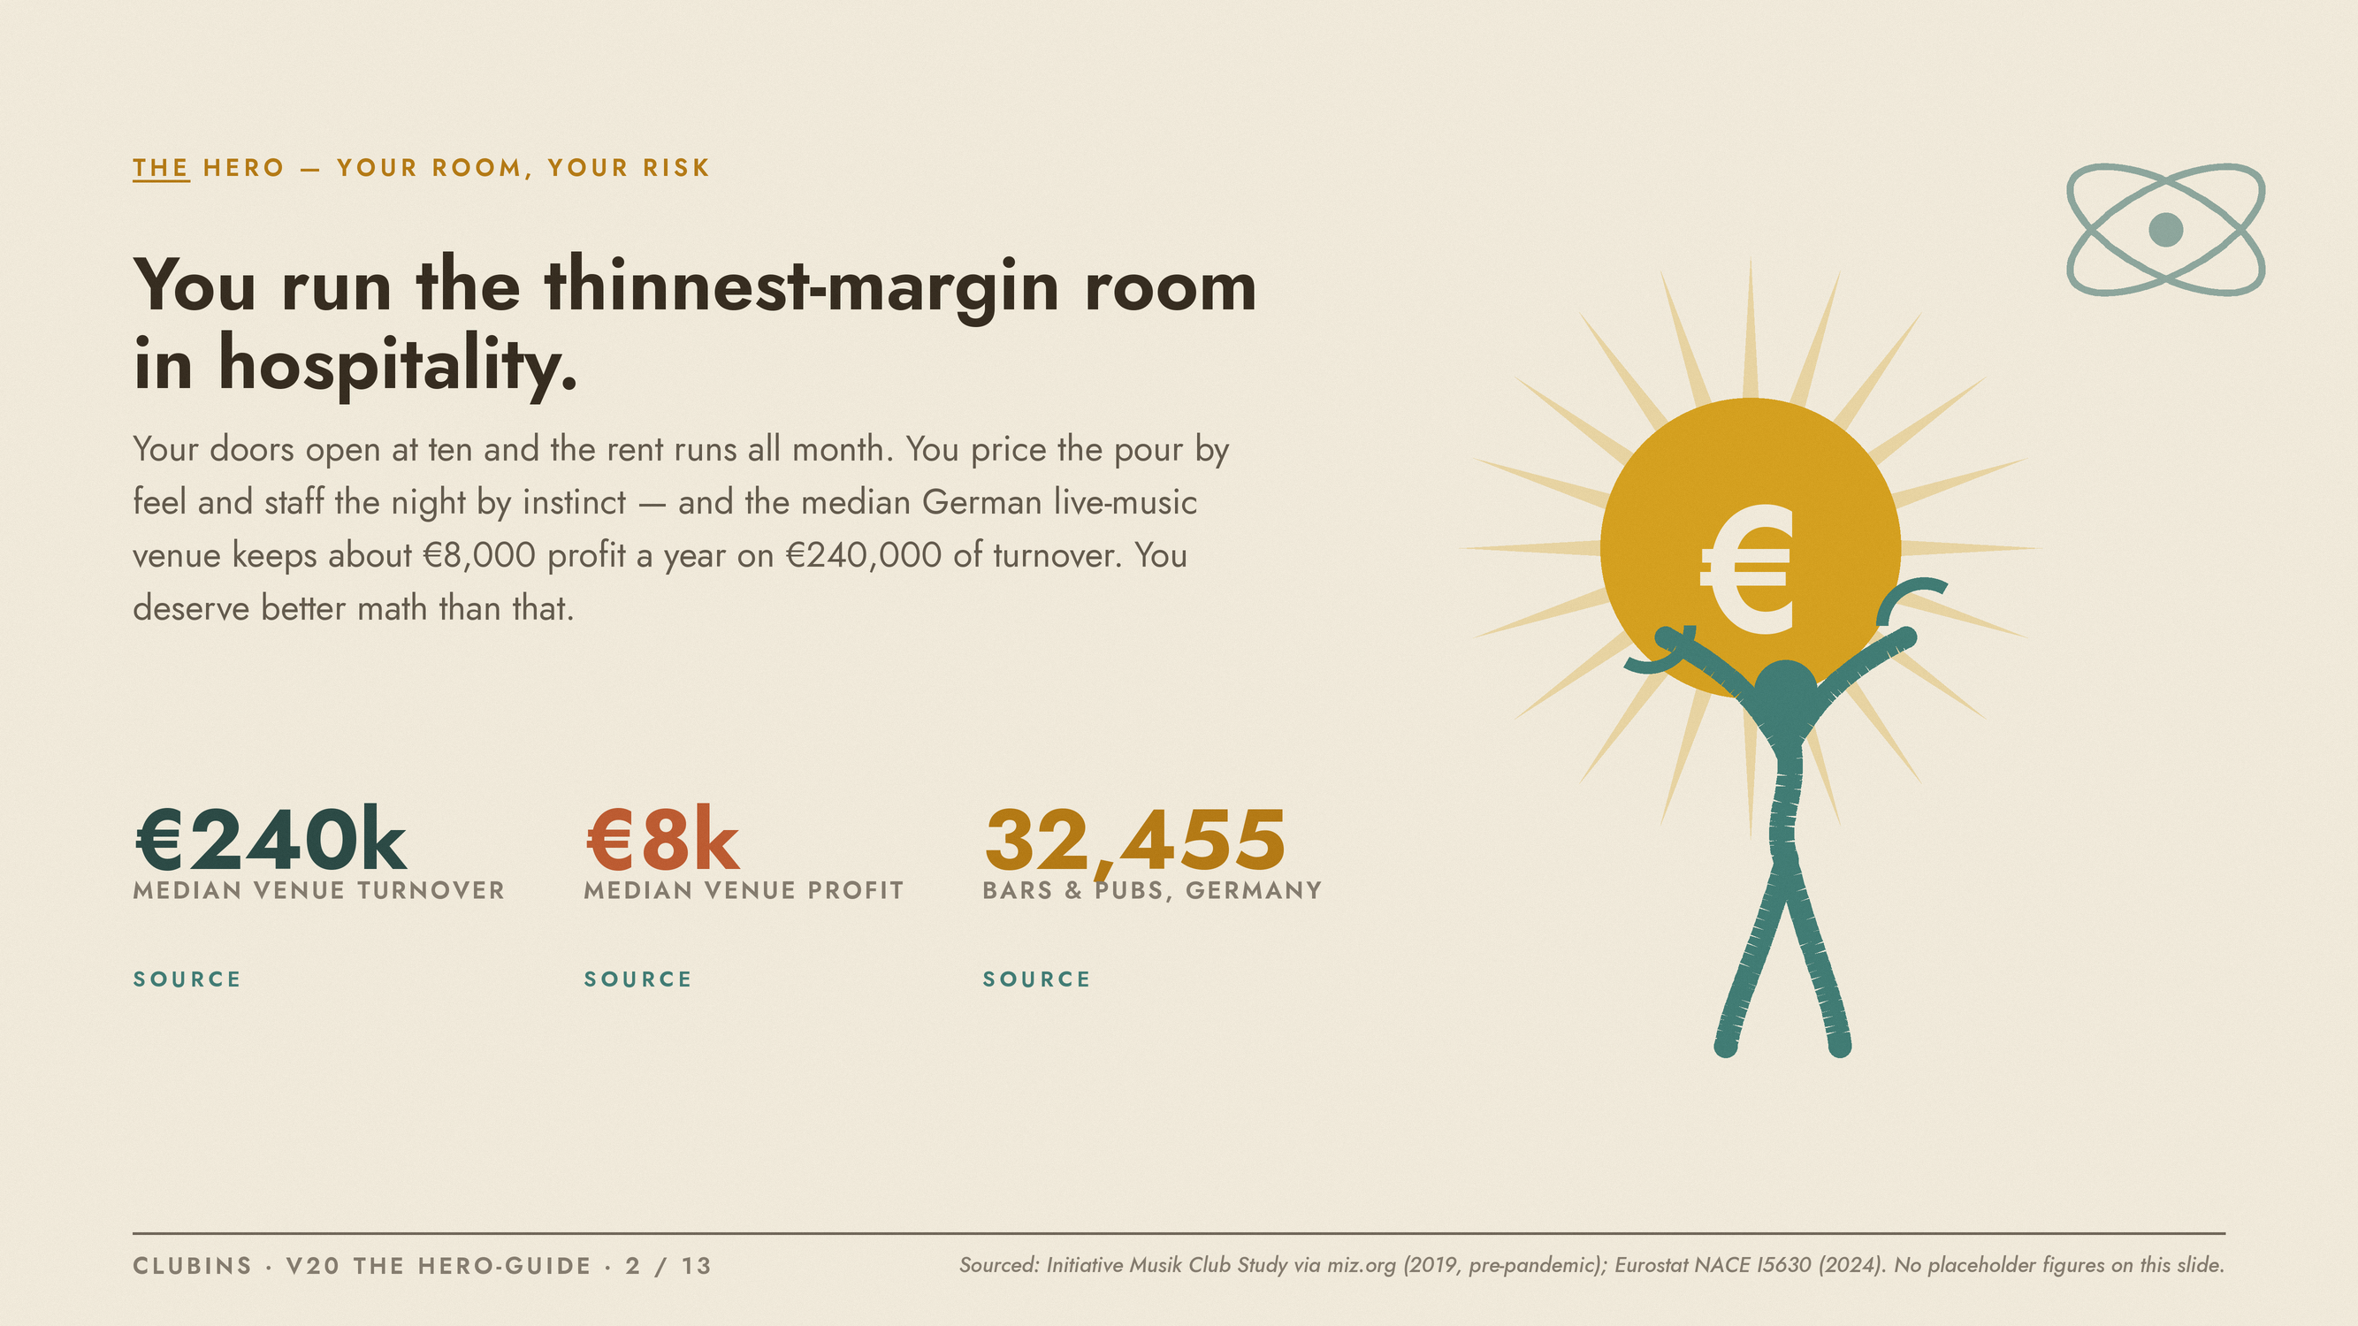
Notes:
The hero's world: thin margins, felt not measured. Market stats sourced, not invented: Initiative Musik Club Study via miz.org (2019, pre-pandemic; median EUR 240k turnover / EUR 8k profit) and Eurostat NACE I5630 (2024; 32,455 bars & pubs, EUR 8.05B turnover). No placeholder figures here.

Slide 3
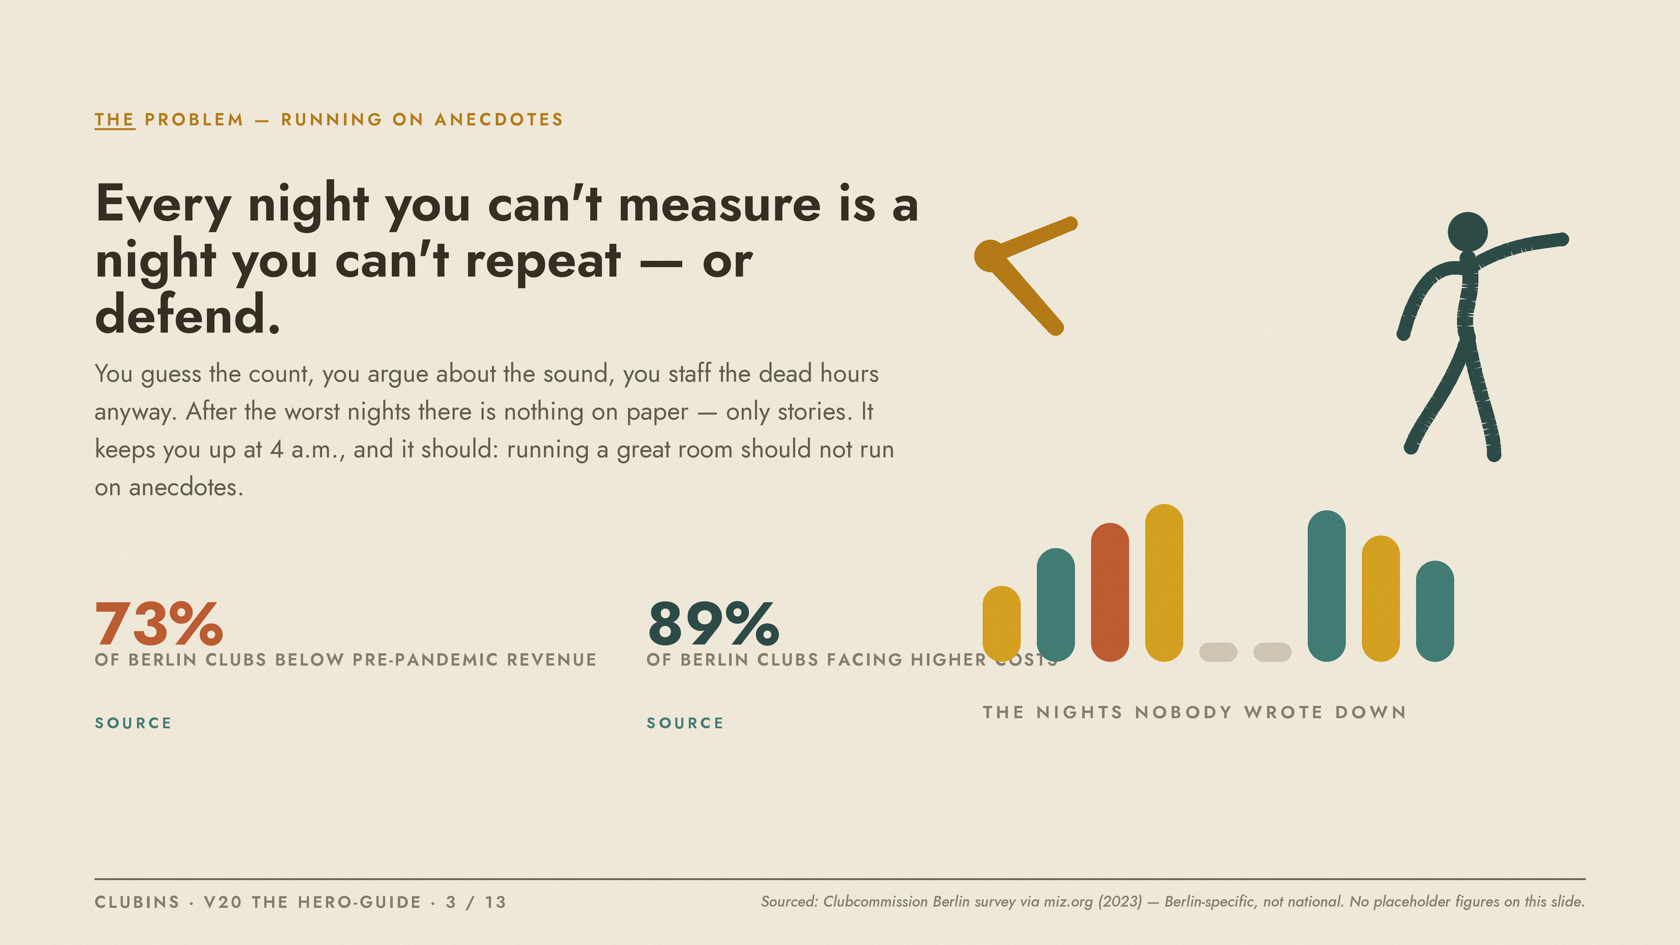
Notes:
SB7 problem beat: external (unmeasured nights), internal (the 4 a.m. doubt), philosophical (great rooms should not run on anecdotes). Berlin figures are the 2023 Clubcommission survey via miz.org - Berlin-specific by the honesty rule.

Slide 4
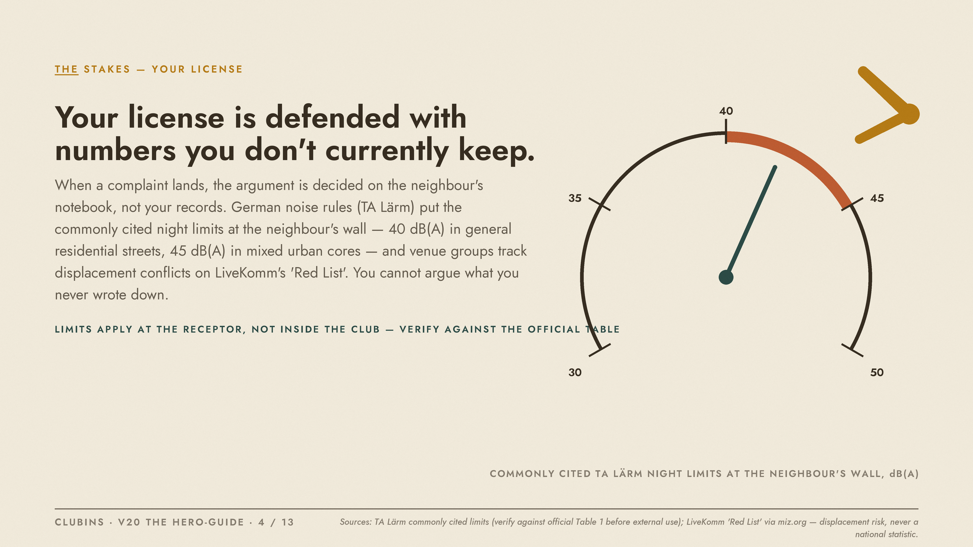
Notes:
License stakes. TA Laermm limits quoted as commonly cited, receptor-side, verify against the official Table 1 before external use. Noise is framed as documented displacement risk (LiveKomm 'Red List' via miz.org), never a fake national statistic.

Slide 5
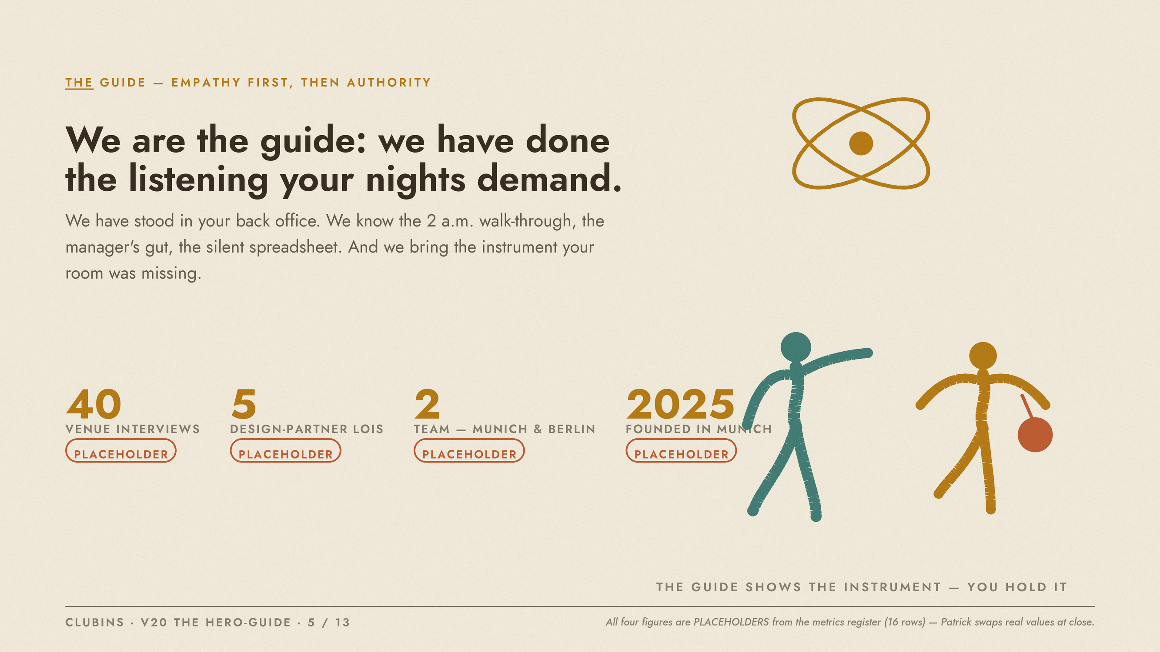
Notes:
SB7 guide beat: empathy first, then authority. All four figures (40 interviews, 5 LOIs, team of 2, founded 2025) are PLACEHOLDERS from the 16-row Placeholder Metrics Register (wb_cg3xEK66).

Slide 6
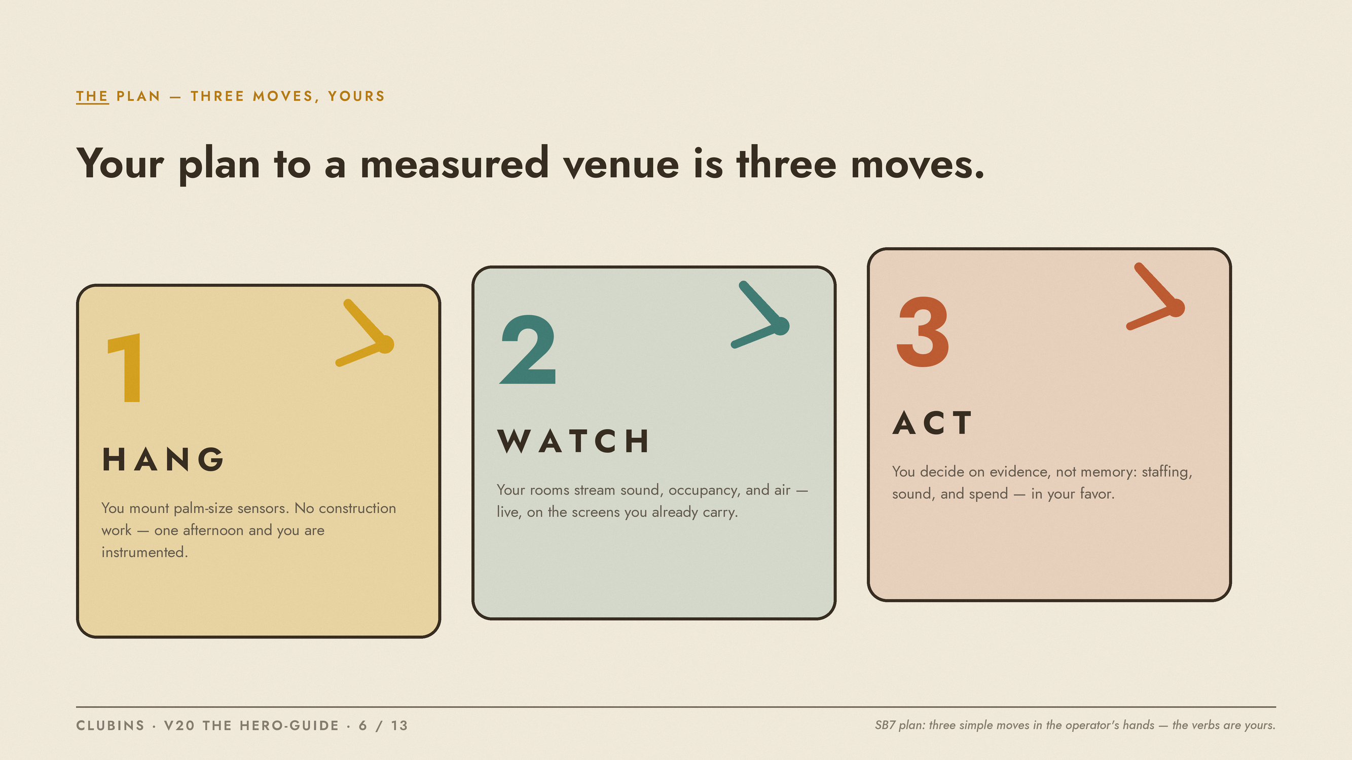
Notes:
SB7 plan beat: three simple moves in the operator's hands - Hang, Watch, Act. The verbs stay yours.

Slide 7
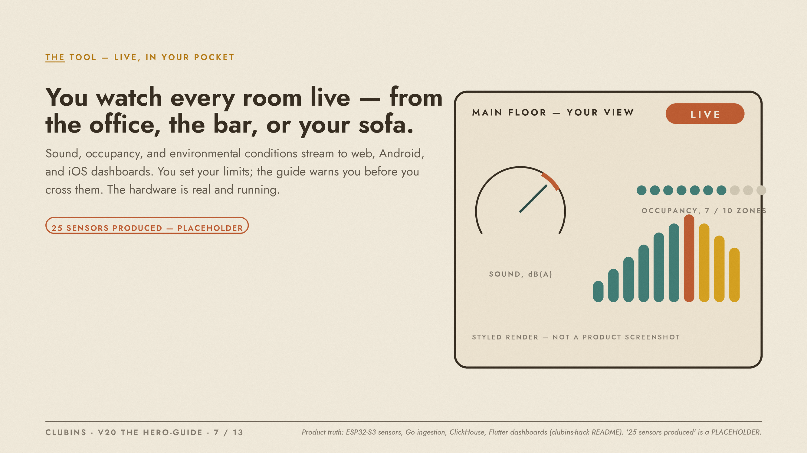
Notes:
The tool the guide hands the hero. Styled poster render, deliberately not a product screenshot. '25 sensors produced' is a PLACEHOLDER from the register.

Slide 8
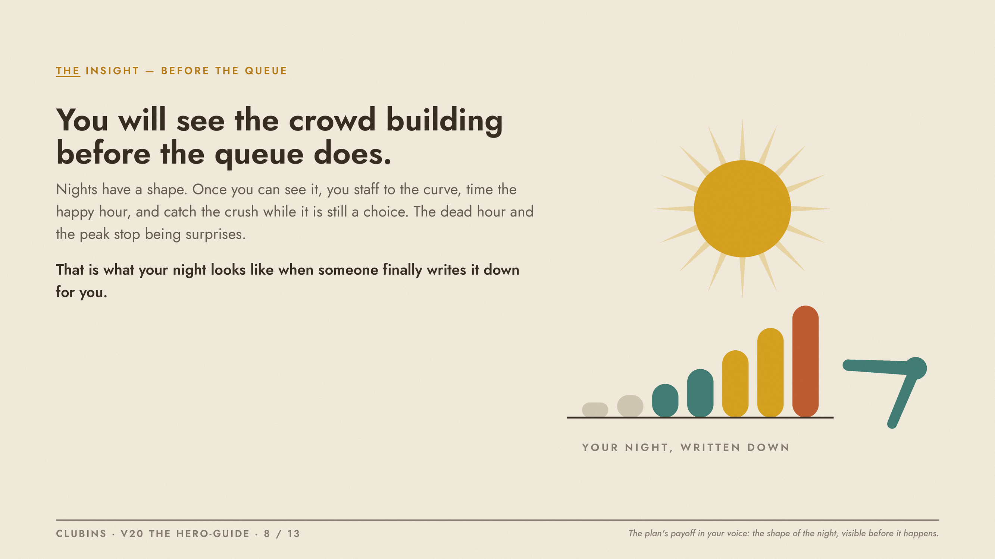
Notes:
Insight beat: the plan's payoff in the operator's voice - the shape of the night, visible before it happens.

Slide 9
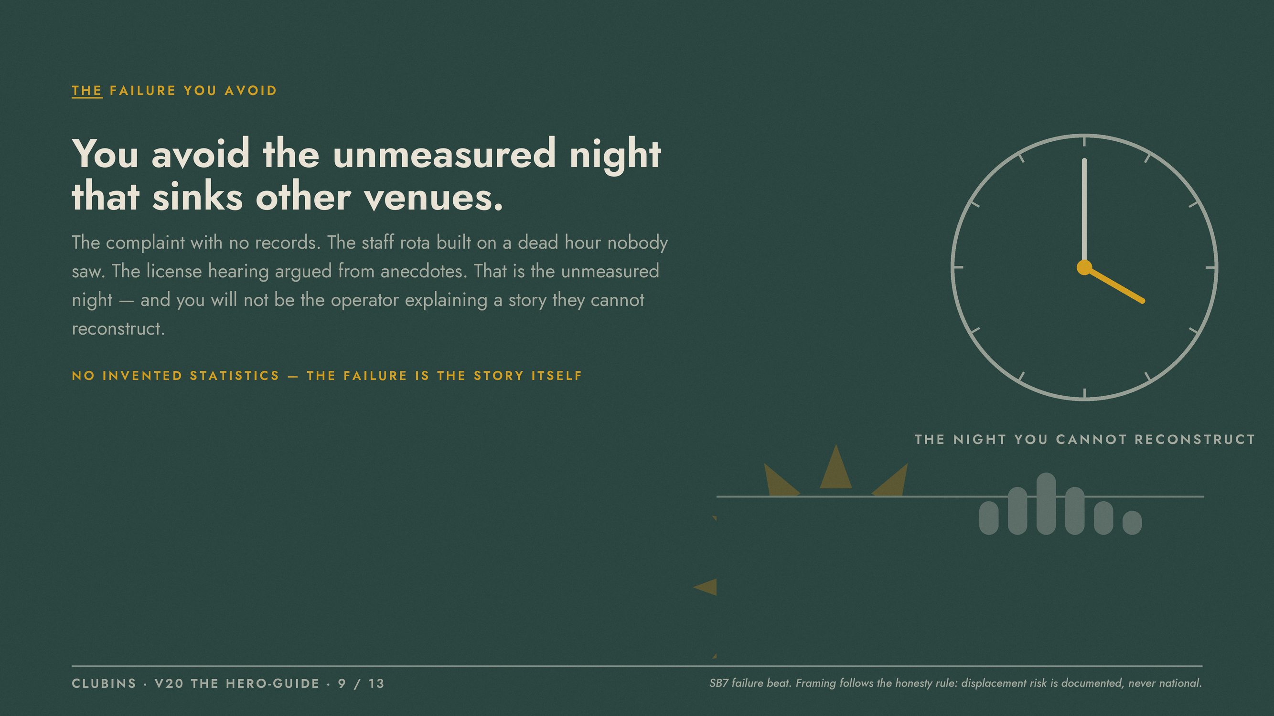
Notes:
SB7 failure beat: 'the unmeasured night'. No invented statistics on this slide; the failure is the story itself, per the honesty rule.

Slide 10

Notes:
SB7 success beat. '120 waitlist venues' is a PLACEHOLDER from the register.

Slide 11
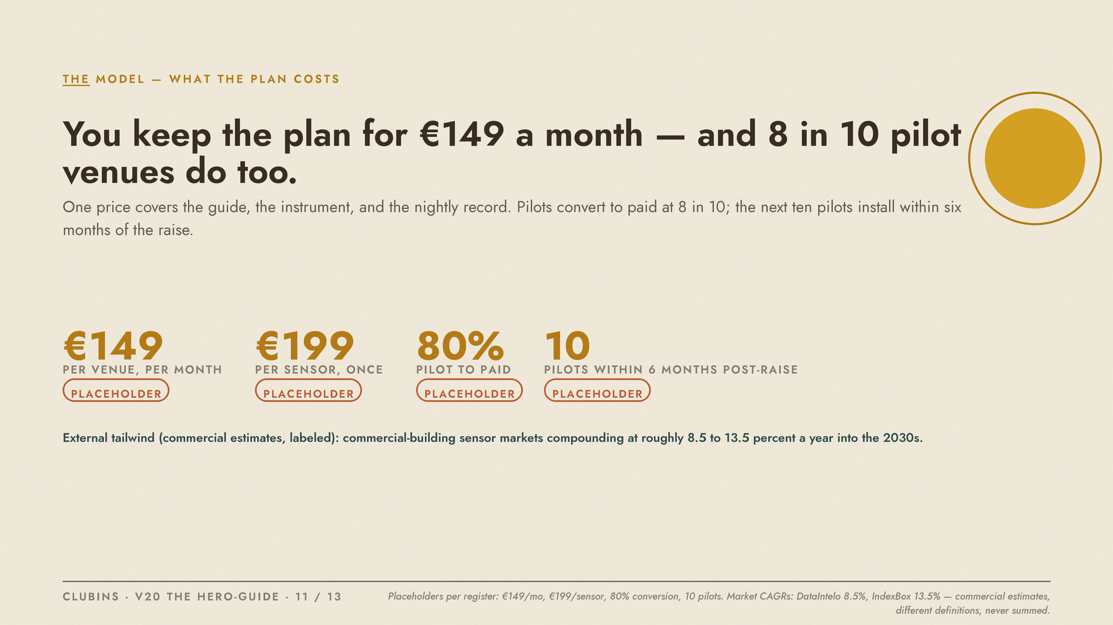
Notes:
Model economics for the investor, still voiced to the operator. EUR 149/mo, EUR 199/sensor, 80% pilot-to-paid, 10 pilots post-raise are all PLACEHOLDERS. Sensor-market CAGRs (DataIntelo 8.5%, IndexBox 13.5%) are labeled commercial estimates with different definitions - never summed.

Slide 12
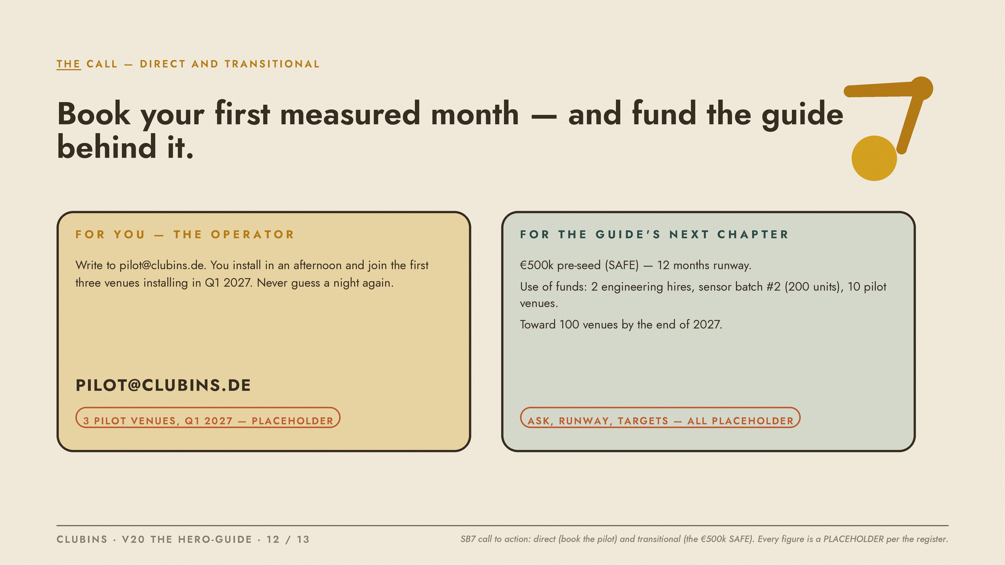
Notes:
SB7 call to action: direct (book the pilot) and transitional (the EUR 500k SAFE). Every figure is a PLACEHOLDER per the register.

Slide 13
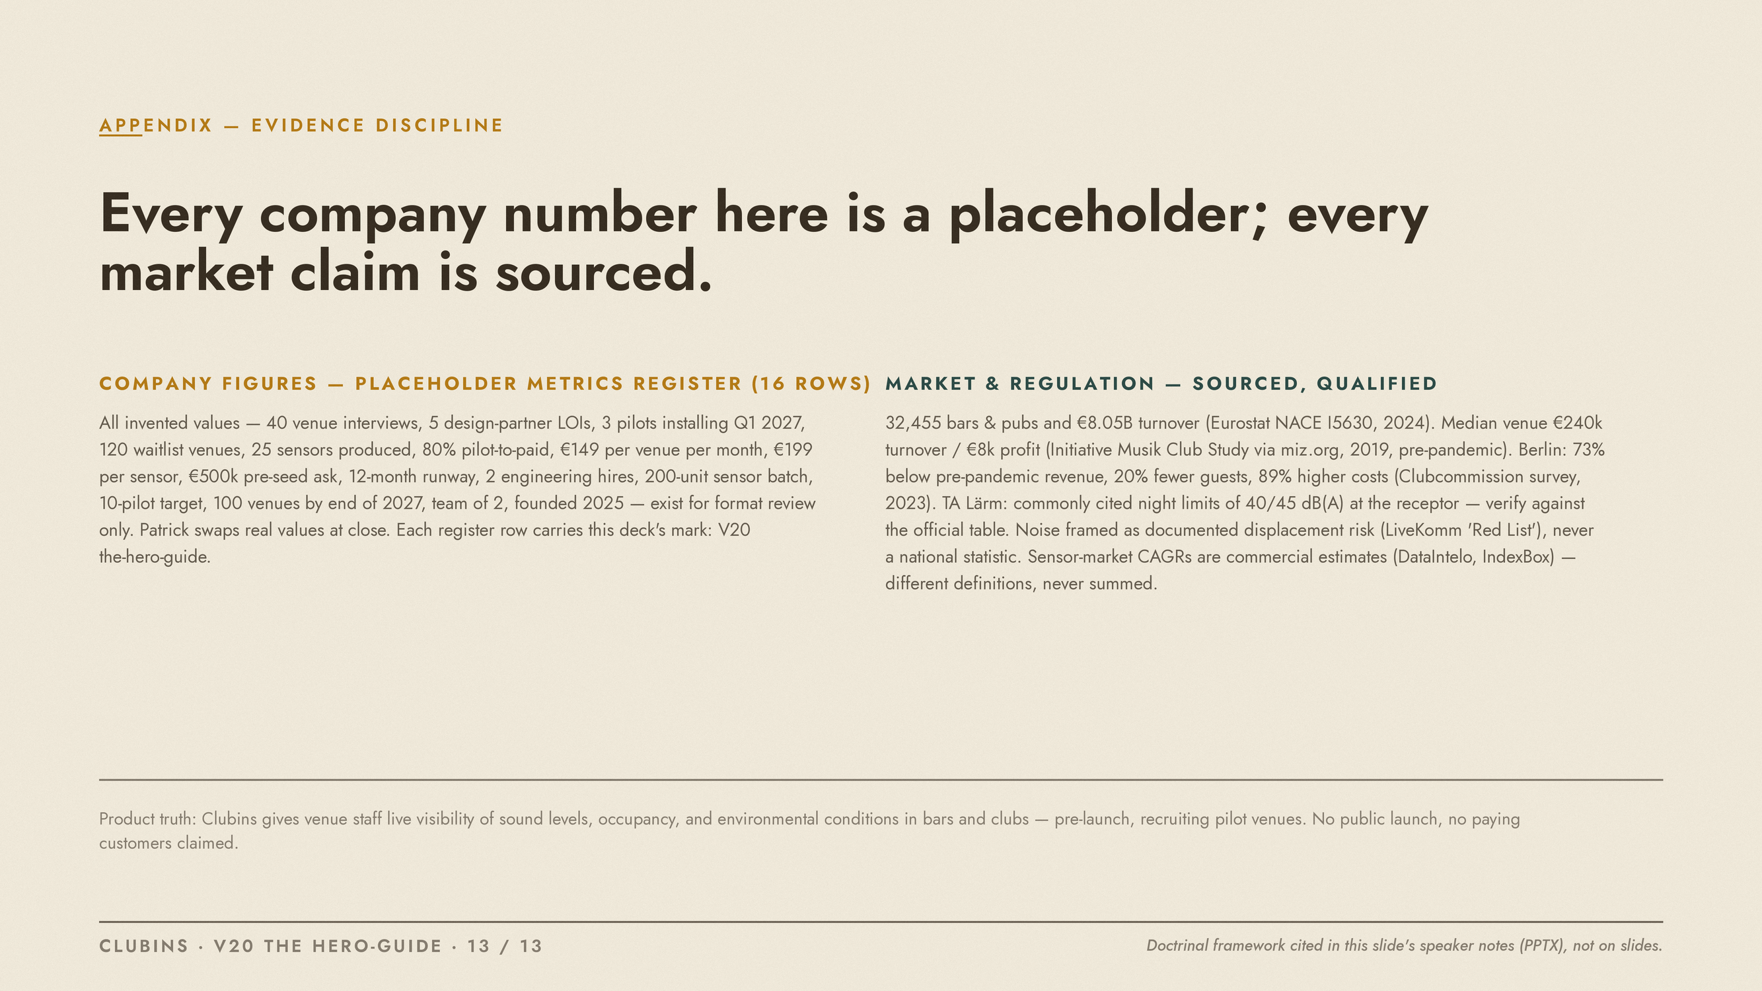
Notes:
APPENDIX - EVIDENCE DISCIPLINE. Doctrine source (cited here in notes, not on slides): Donald Miller, 'Building a StoryBrand: Clarify Your Message So Customers Will Listen' - the SB7 framework: the customer (the venue operator) is the hero; the brand is the guide with empathy and authority; the guide gives a plan and calls the hero to action, naming the failure avoided (the unmeasured night) and the success won. Applied deck-wide, V20, wave four. Company numbers: Placeholder Metrics Register (wb_cg3xEK66, sheet sh_vpK5zAbf), all 16 rows status PLACEHOLDER, marked 'V20 the-hero-guide'. Market/regulation claims: Clubins Market & Regulation Facts (art_mYolRwiM), qualified on-slide.

